Slide 1



Mathematics for Computing - 22MAT122
Elements of Computing II - 22AIE113
IMAGE ENCRYPTION AND DECRYPTION USING CNNs

Slide 2
GROUP DESCRIPTION
Anakha S- CB.SC.U4AIE24006
Chaithanya G Nambiar-CB.SC.U4AIE24013
Surabhi Saha-CB.SC.U4AIE24057
Sriram S - CB.SC.U4AIE24066

Slide 3
INTRODUCTION
In today’s digital world, secure image transmission is crucial for protecting visual data from unauthorized access.
Traditional encryption methods like AES are widely used but may not preserve image quality when visual integrity is important.
Deep learning approaches like CNNs offer an alternative by learning to encode and decode image data with minimal quality loss.

Slide 4
OBJECTIVES
To compare the performance of traditional AES CBC encryption with a CNN-based method for image cryptography.
To evaluate and analyze both techniques using metrics such as MSE, PSNR, and SSIM.
To build a user-friendly application that visualizes encryption, decryption, and performance metrics for each method.

Slide 5
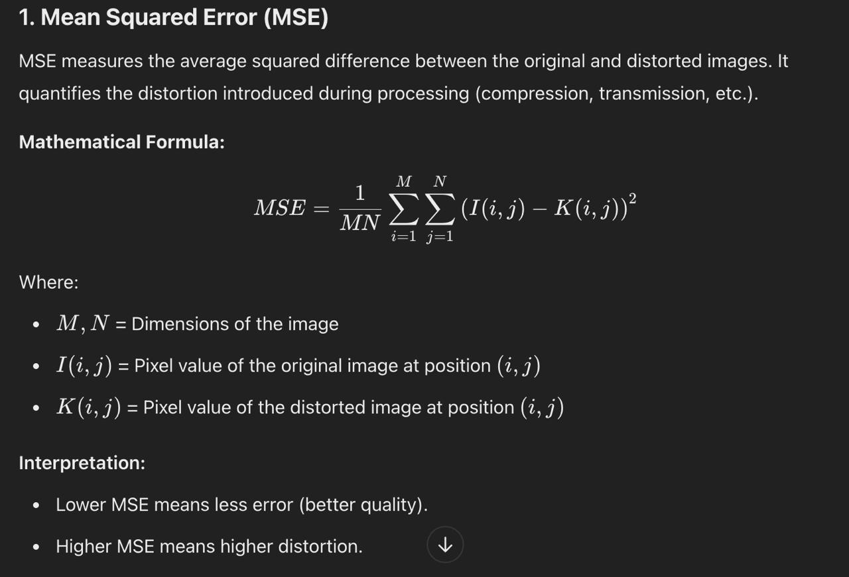
METRICS USED

Slide 6
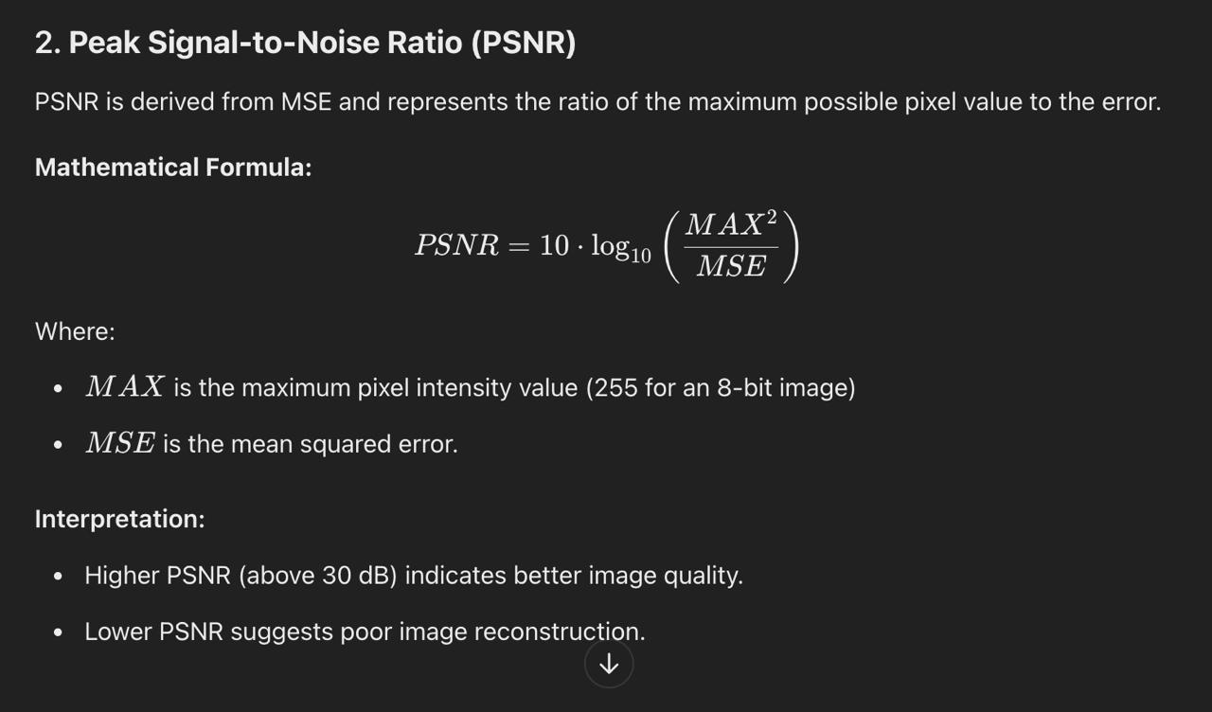

Slide 7
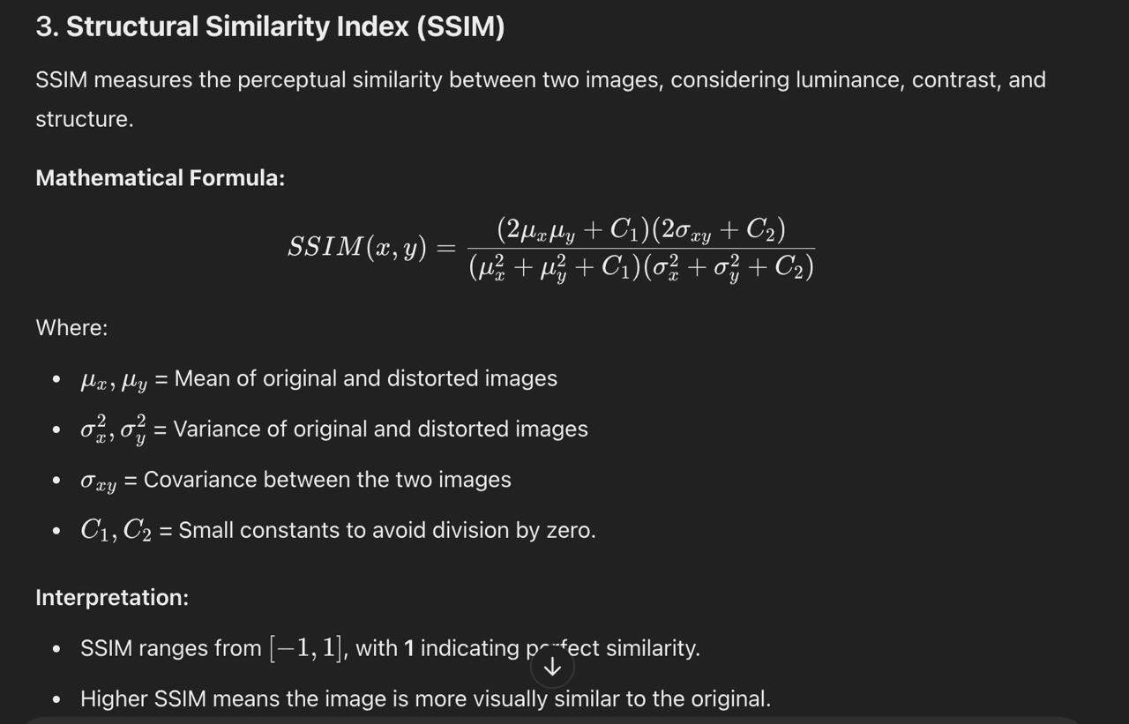

Slide 8
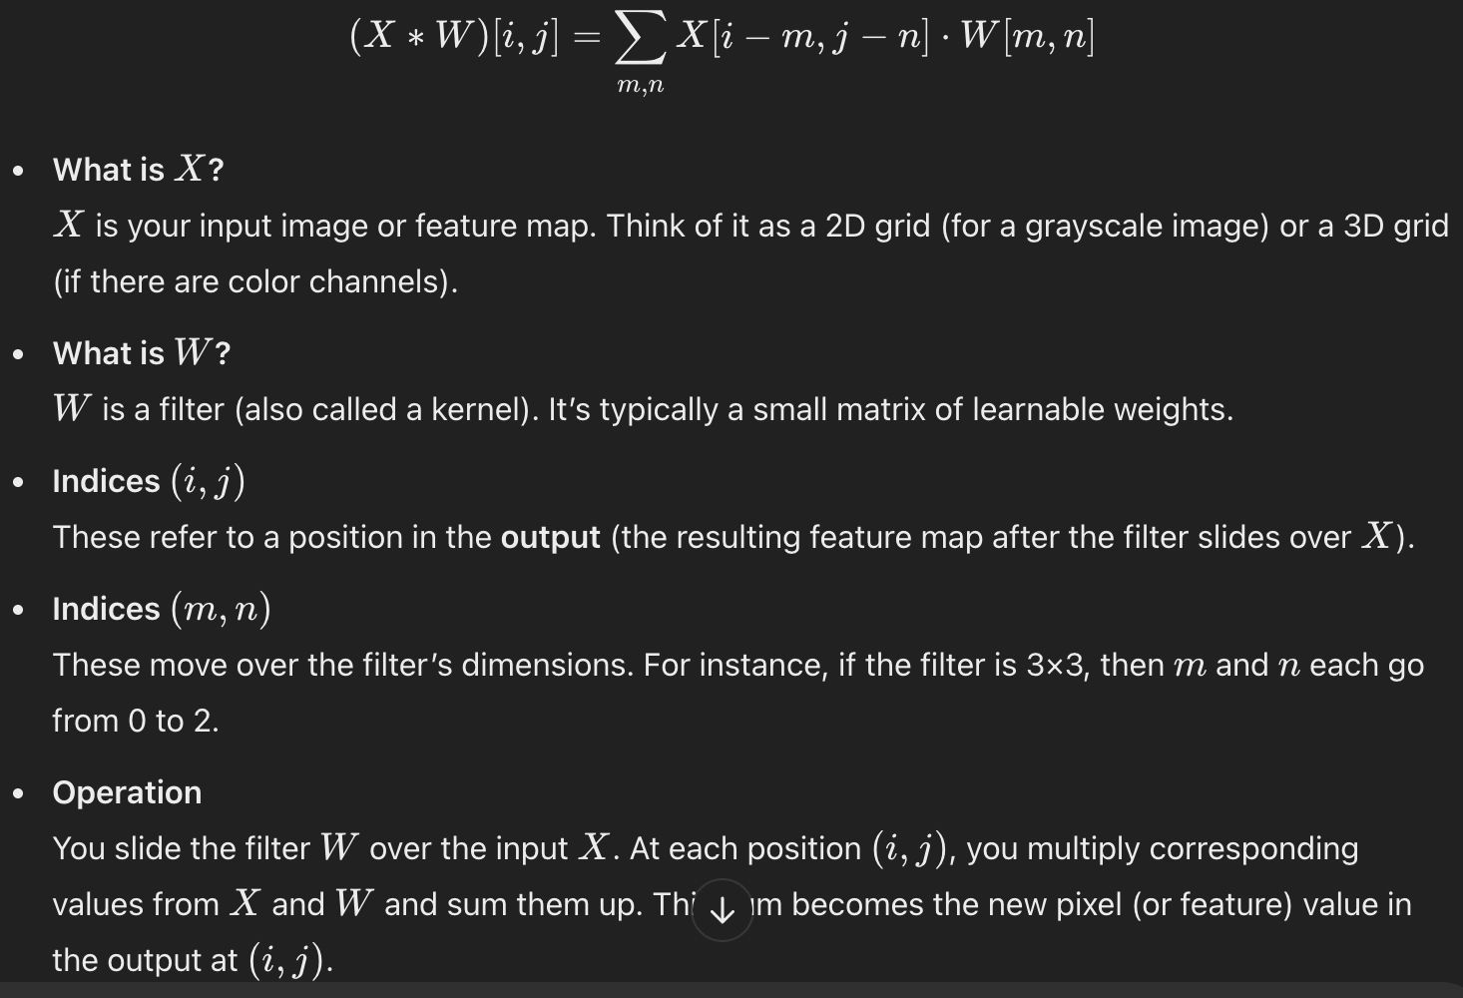
CNN METHOD
Purpose: Convolution helps extract specific features (edges, textures, shapes) from the input. Different filters learn to detect different patterns.

Slide 9
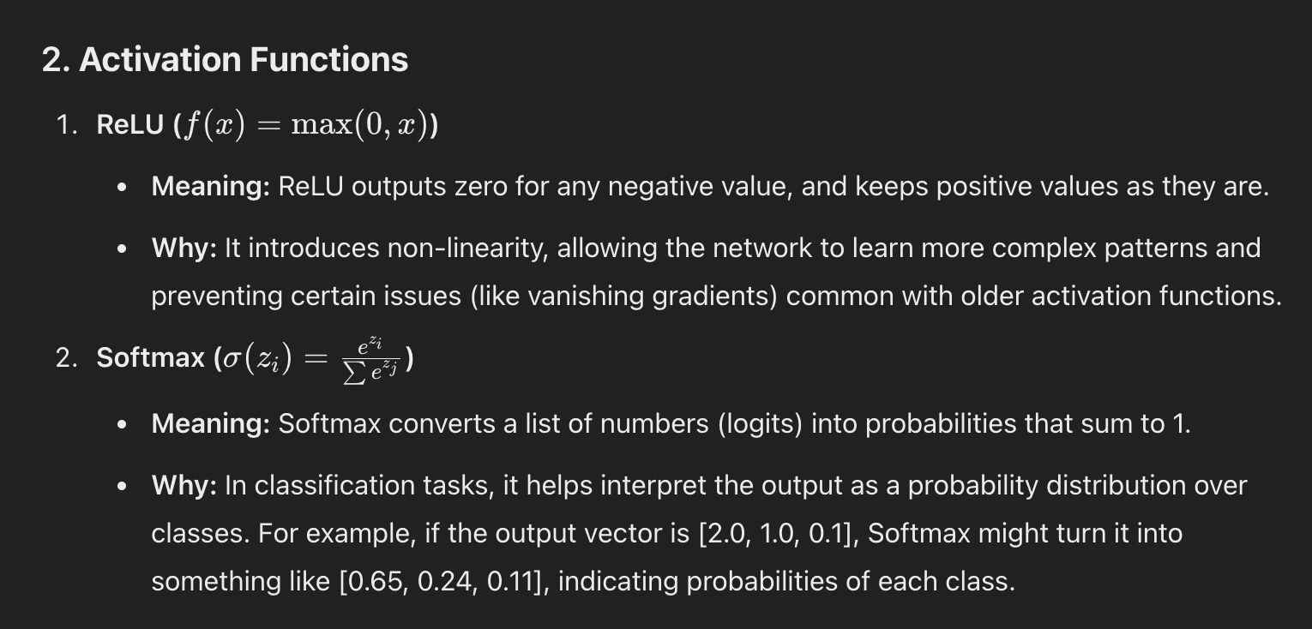

Slide 10
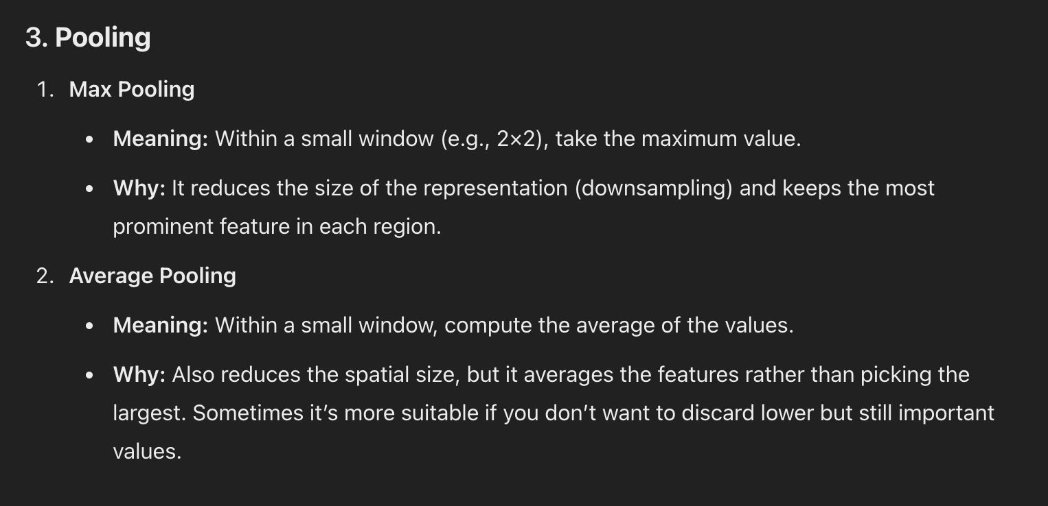

Slide 11
METHODOLOGY

Slide 12


KEY COMPONENETS OF CNN
Convolutional Layers: Extract features (edges, textures) by sliding a filter over the image.
Activation Function (ReLU) : Introduces non-linearity for complex pattern learning.
Pooling Layers (Max Pooling) : Reduces feature map size, retaining essential information.
Fully Connected Layers: Process extracted features for final decision-making.
Softmax/Sigmoid Output Layer: Produces the probability distribution for classification.

Slide 13
HOW CNN CAN BE IMPLEMENTED
Image Encryption: A CNN model learns to transform original images into encrypted versions by extracting features and mapping them to a secure format.
Image Decryption: A second CNN model reverses the encryption, recovering the original image by minimizing the loss between the decrypted and original image.
Comparison with AES: Unlike AES (which encrypts images block-wise), CNN encryption learns a direct transformation, preserving more image details.
Training & Evaluation: The dataset is used for training, and encryption quality is measured using PSNR and SSIM to compare CNN and AES performance.

Slide 14
WHAT IS AES ?
AES is a symmetric encryption algorithm that encrypts data in fixed-size blocks (e.g., 128 bits) using a secret key.
CBC mode enhances security by:
XORing each plaintext block with the previous ciphertext block before encryption.
Using an Initialization Vector (IV) for randomness in the first block.
This ensures that identical plaintext blocks produce different ciphertexts.

Slide 15
IMPLEMENTATION OF AES FOR COMPARISON WITH CNN
Encryption Using AES-CBC:
Encrypt each block using AES with a secret key and IV.
Combine encrypted blocks to form the final encrypted image.
Decryption Using AES-CBC:
Split the encrypted image into blocks.
Decrypt each block using AES key and IV.
Reassemble blocks to reconstruct the original image.
Comparison with CNN-Based Encryption:
AES encrypts block-by-block, while CNN learns an end-to-end encryption process.
AES may cause data loss, while CNN preserves more image details.
Evaluation using PSNR and SSIM to compare image quality after decryption.
This comparison helps determine which method is more secure and retains better image quality.

Slide 16
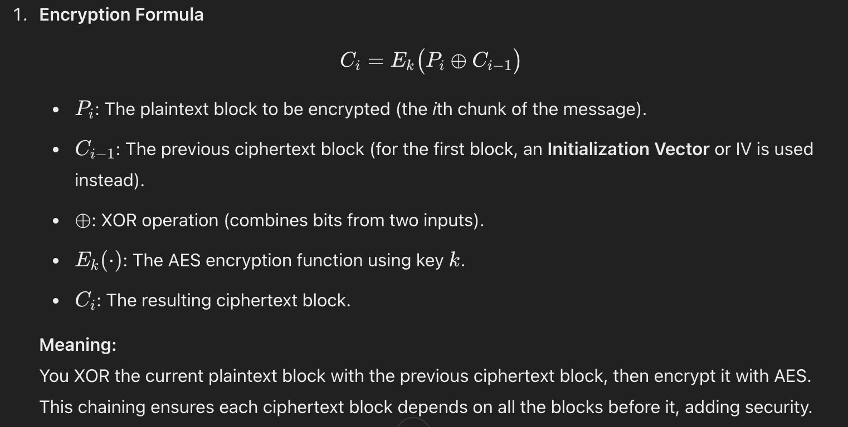

Slide 17
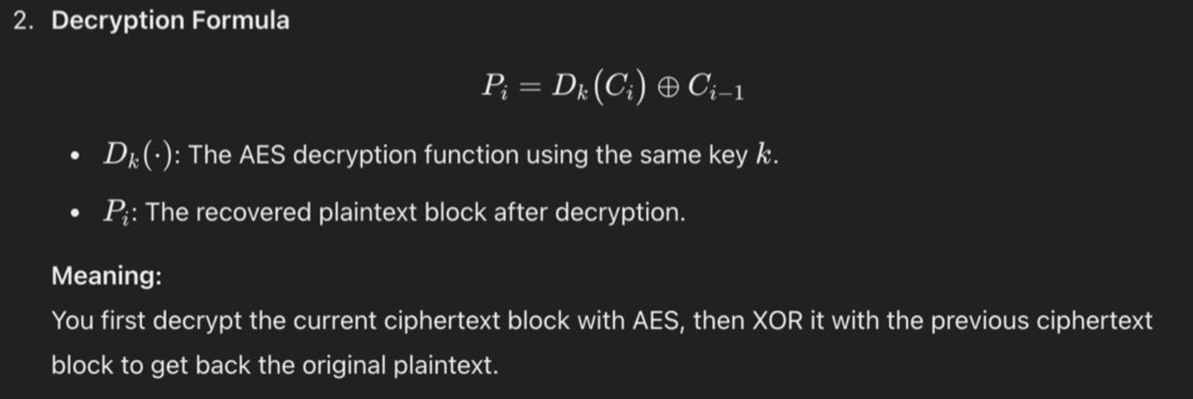

Slide 18
DATASET DETAILS
DIV2K Dataset
High-Resolution Dataset: DIV2K stands for DIVerse 2K resolution images, designed for super-resolution and image quality tasks.
Large and Diverse Collection: Contains 800 training, 100 validation, and 100 test images in high-quality PNG format (around 2K resolution).
Variety of Image Categories: Includes urban scenes, nature, people, vehicles, architecture, and indoor objects—covering real-world diversity.
Used in Our Project: Images resized to 256×256 and used for training CNN and testing AES encryption/decryption with quality metrics (MSE, PSNR, SSIM).

Slide 19
RESULTS

Slide 20

AES encryption

Slide 21
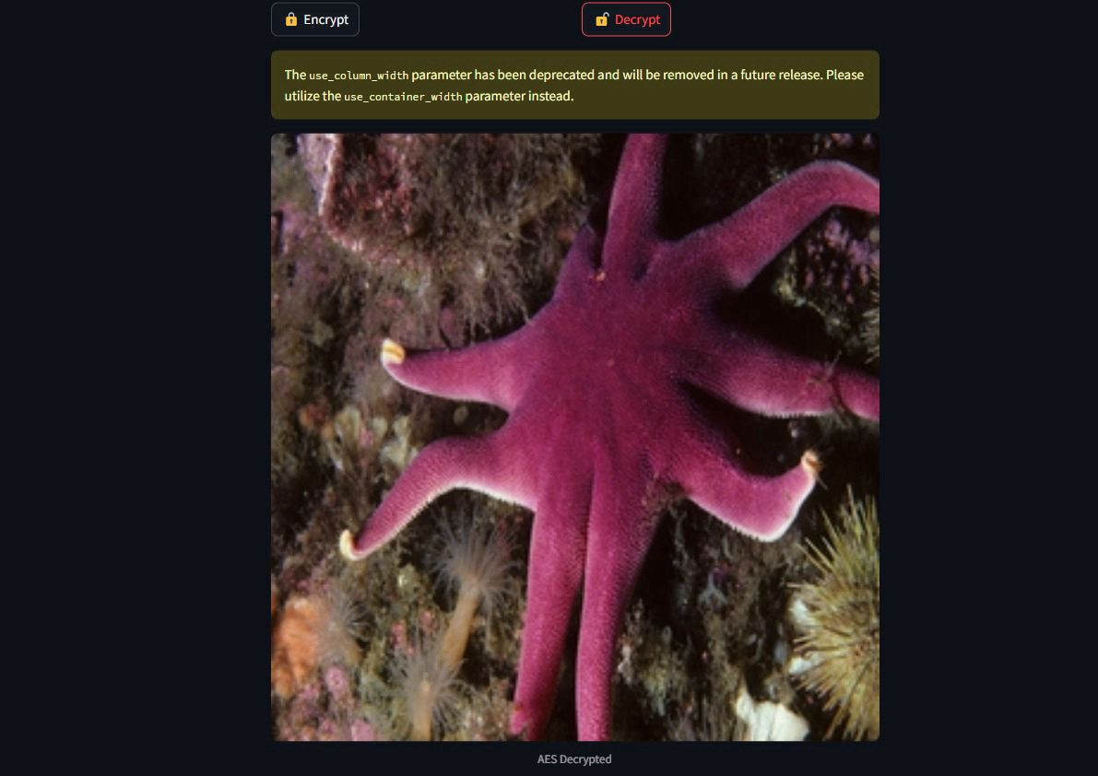
AES decryption

Slide 22
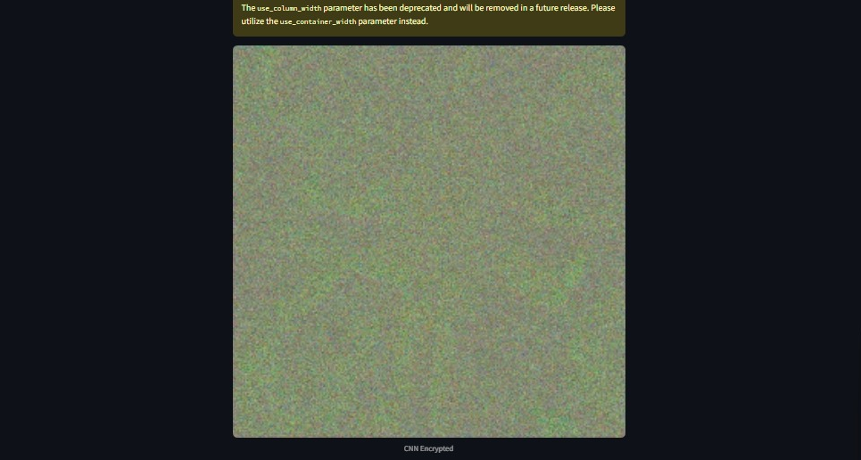
CNN Encryption

Slide 23
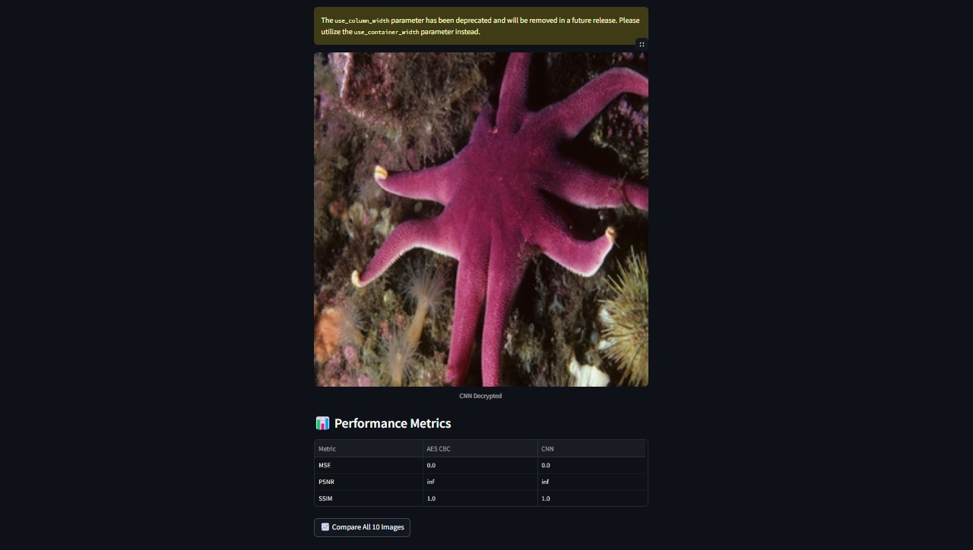
CNN Decryption

Slide 24
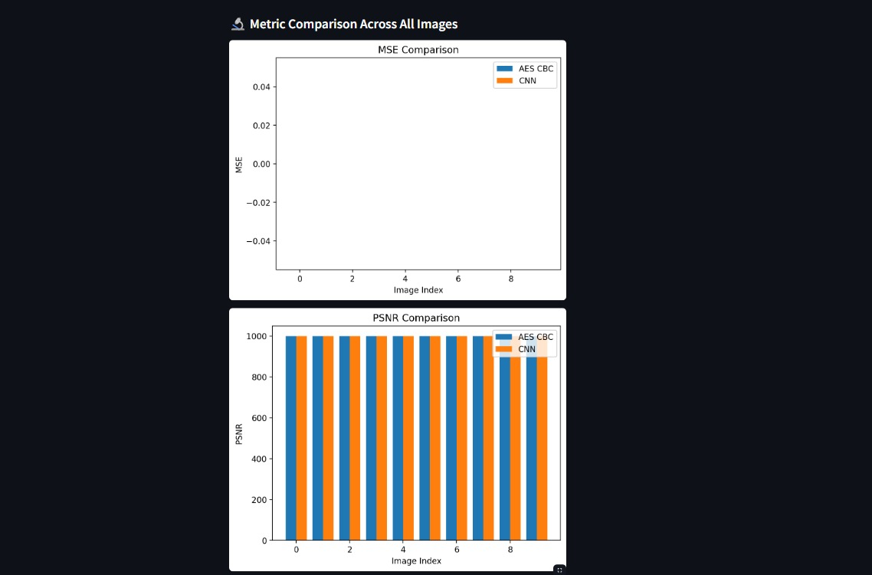

Slide 25
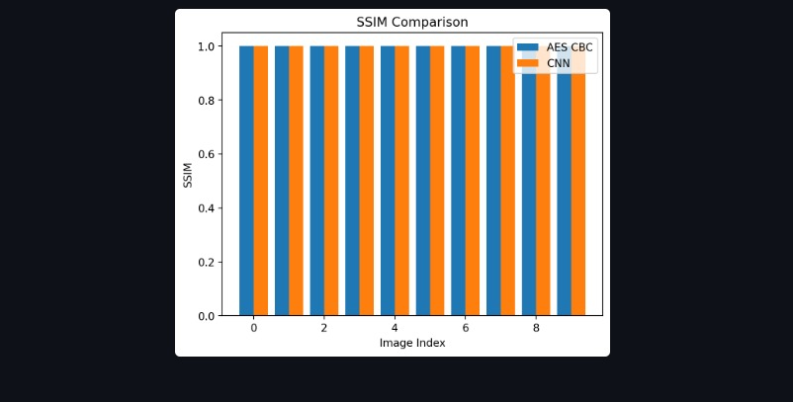

Slide 26
APPLICATIONS
Digital Communication: Secure transmission of encrypted images over the internet (e.g., emails, messaging platforms).
Medical Imaging: Encrypting sensitive patient data (such as medical scans) to prevent unauthorized access.
E-Commerce: Protecting product images in online catalogs, ensuring that they are encrypted during transmission.
Cloud Storage: Securing images stored in cloud services to prevent data breaches or theft.

Slide 27
CONCLUSION
Both AES CBC and CNN methods successfully decrypted images with zero error (MSE = 0), showing perfect reconstruction in this setup.
PSNR and SSIM values are identical for both methods, indicating that image quality after decryption is visually and structurally the same as the original.
AES CBC encryption works at the byte level, providing strong cryptographic security while still achieving lossless decryption here.
The CNN model acts as a perfect autoencoder, learning to reconstruct the image without introducing any distortion.
Overall, both methods perform equally well in terms of image quality, but AES offers real encryption, while the CNN model would need further enhancements to be cryptographically secure.

Slide 28
FUTURE WORK
Train the CNN model on larger and more diverse datasets to improve its generalization and potentially add real encryption behavior beyond reconstruction.
Implement adversarial testing and attack simulations to evaluate the resistance of both AES and CNN methods against image-based security threats.

Slide 29
PROPOSED TIMELINE
Week 1-2: Literature review and dataset selection (CIFAR-10).
Week 3-4: Implementation of AES encryption and decryption in Python.
Week 5-6: Implementation of CNN-based cryptography using TensorFlow.
Week 7: Testing and evaluation of both models.
Week 8: Comparison, accuracy assessment, and final report preparation

Slide 30
THANK YOU!

